Slide 1
Creating a Dynamic Lift System for Assisted Mobility
Author
Dustin Branges
Mentors:
Dr. Sarah Oman
Dr. Kyle Winfree

Slide 2
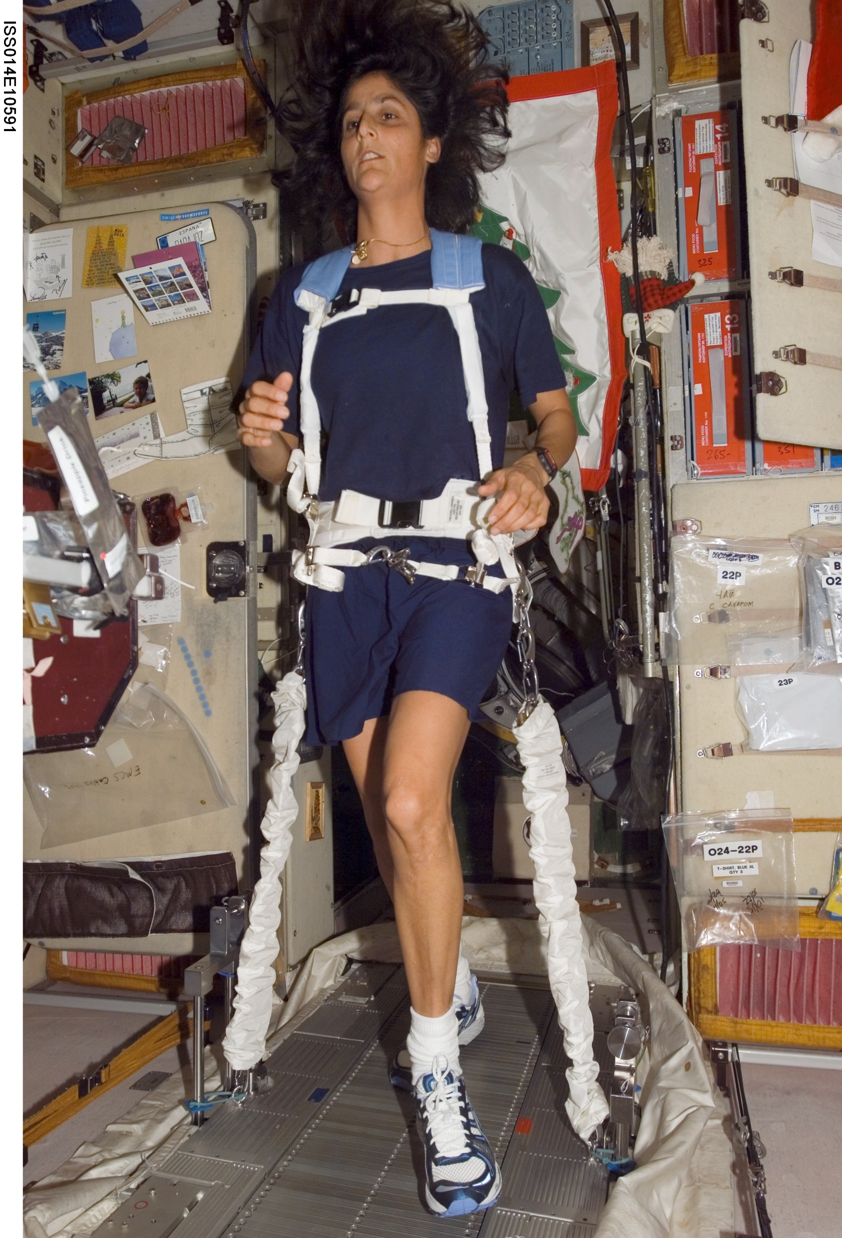
Why is This Important?
During 6 month expeditions aboard the International Space Station, astronauts lost on average:
  13% muscle volume
  32% peak power
  9% bone mass
Full recovery can take as long as 3-4 years
Notes:
In a study of the Effect of prolonged space flight on the human skeletal muscle systems NASA found that even with a strict dietary and exercise regimen in place, including the use of the Combined Operational Load-Bearing External Resistance Treadmill, pictured here, members of the International Space Station experienced a loss of skeletal muscle mass, strength and bone density. Through biopsies and other testing they found that astronauts returning from 6 month expeditions lost on average 13% muscle volume, 32% peak power and 9% bone mass with full recovery taking at least 3 to 4 years
As we travel further into space these symptoms will likely only continue to increase and as a result we will need something such as our proposed device in place upon their return to earth.

Slide 3

Other Important Applications
Stroke survivors
Patients with traumatic brain injuries
Lower extremity amputees
Individuals with limited self-mobility
Notes:
While this project was initially designed to help returning astronauts recover from the effects of extended space travel, there are also millions of individuals who could benefit from our proposed system. Such as in the United States alone, each year there are over:
650,000 stroke survivors who will often suffer from some form of mobility impairment.
The 185,000 amputees, of which the majority are lower extremity amputations
And the 5000 children born with cerebral palsy who will be unable to walk independently
Along with many others with limited self-mobility

Slide 4
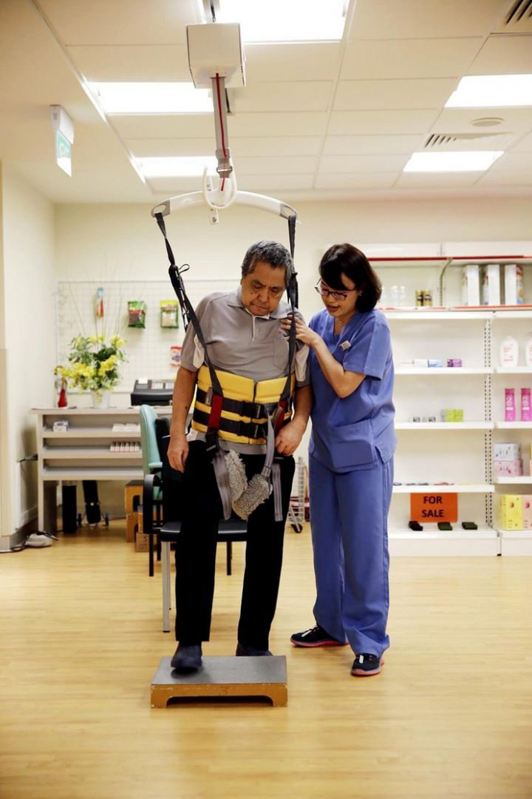
Our Proposed System
Our goal is to address and overcome two of the shortcomings present in most other similar systems:
Free movement anywhere within the frame of the system
Dynamic weight support
Notes:
Our goal with our proposed system is to overcome the shortcomings present in most other systems. The two Traditional types of systems, often called gait trainers or gait and balance systems use a harness connected to either an overhead mounted track which the patient is required to follow, or they are fixed above a treadmill that the patient walks on.
Our system would allow the patient to freely move anywhere within the frame of the system and also be able to lift for the patient, a percentage of their own body weight which can be increased or decreased as needed

Slide 5
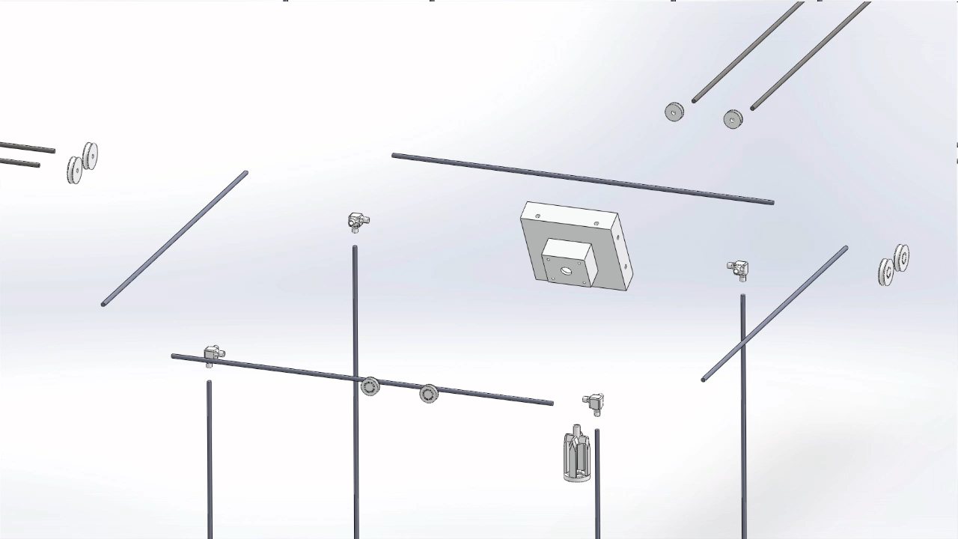
Free Movement
Achieved by using a head unit that tracks the individual’s movement and is able to follow in any direction within the framed system
Notes:
To allow free movement within a room several designs were modeled in SolidWorks, with two versions ultimately prototyped.
The initial prototype built had two motorized wheels located on each outer rail. While functional the design was overly complicated and required excessive lengths of wire running to each motor and was prone to wires becoming tangled and disconnected.
CLICK TO NEXT SLIDE FOR VIDEO!!

Slide 6
Free Movement
Achieved by using a head unit that tracks the individual’s movement and is able to follow in any direction within the framed system
Notes:
The current prototype, as seen modeled on this slide, has all electrical parts centrally located in the head unit and has free spinning wheels along the outer frame, allowing for a much simpler design.
The movement of the system is controlled through the head unit, which senses the direction of the individual’s movement through a modified 8-way arcade style joystick. The joystick then triggers 1 or 2 micro-switches which then close the circuit between the power supply and the corresponding motors. The motors then cause the head unit to move following the direction of pull from the joystick. This keeps the head unit located directly above the individual as they walk around.
This design also has the added bonus of being more easily adaptable for future plans, such as allowing continuous free movement from one room to another

Slide 7
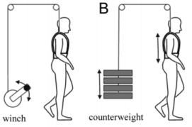
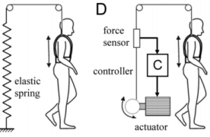
Dynamic Weight Support
Future Goals:
Support a percentage of the individual’s weight
Potential fall arrest
Allow for vertical movement
Notes:
While I currently have been unable to solve the issues of dynamic weight support during this internship, I will be continuing to work with Dr. Kyle Winfree to find a solution that will achieve these goals.
Current methods of dynamic weight support are shown in these images, however they are typically utilized in treadmill based gait trainers. The downfall with these systems is that they are difficult to incorporate into a free movement design. Instead our goal is to create an entirely mechanical solution that can be located fully within the head unit.
If we are able to achieve these goals, the system will be able lift a percentage of the patient’s weight, starting with full weight removal, allowing the patient to focus on the mechanics of their gait. As they progress the amount of weight the system supports can be decreased to facilitate muscle and bone density growth.
Along with providing dynamic support the system will also be able to arrest a fall, similar to how a seat belt in a car is able to lock, protecting the passenger, during a crash.
Lastly our system will allow for vertical movement, enabling the individual to move down to interact with things below what they could reach standing or allow them to move from standing to sitting and vice versa

Slide 8
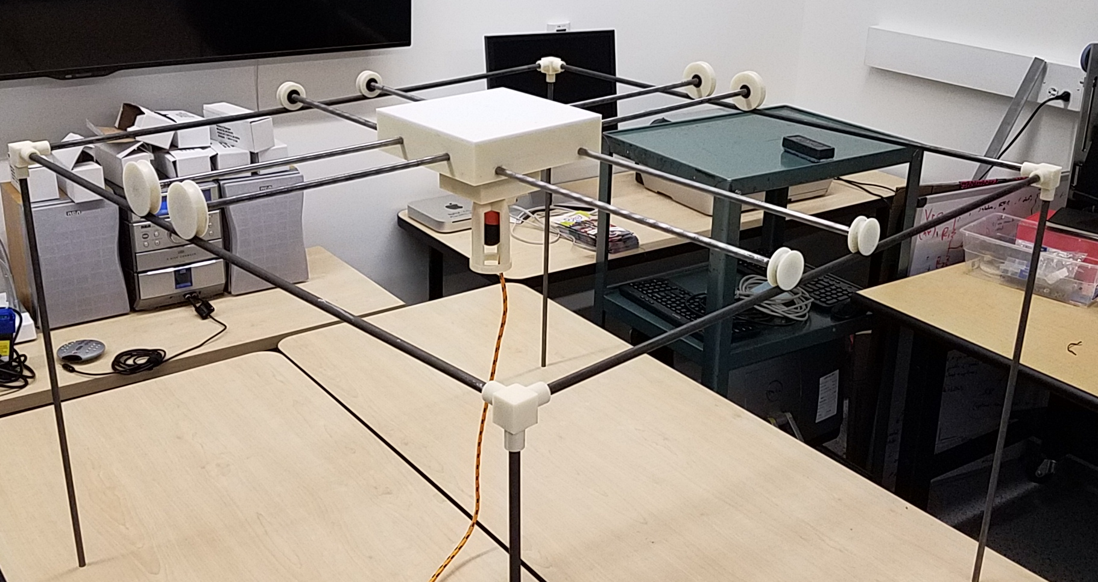
Potential Impacts of Our Project
Increased recovery speed
Independence of movement
Integration into the home and workplace
Notes:
By solving the issues of free movement and dynamic support, this system could increase patient recovery speed along with allowing independent movement.
Our next goal after solving the dynamic lift component is to design and fully integrate this system into a home. allowing a person to freely move within a room as well as move from one room to another, including up and down stairs. Along with the free movement they will also be able to complete tasks, for example bathing, changing clothes, or cooking.

Slide 9
Acknowledgements
Dr. Sarah Oman & Dr. Kyle Winfree
Northern Arizona Space Grant Program
Dr. Nadine Barlow and Sr. Program Coordinator Kathleen Stigmon
The Northern Arizona University Engineering Fabrication Lab and RAPIDLab
Notes:
I would like to thank my mentors Dr. Sarah Oman and Dr. Kyle Winfree for their insight and guidance during this process.
The Northern Arizona Space Grant Program, specifically Dr. Nadine Barlow and Senior Program Coordinator Kathleen Stigmon for this opportunity
And the Northern Arizona University Engineering Fabrication Lab and RAPIDLab where I was able to 3D print and fabricate the parts needed for my prototype

Slide 10
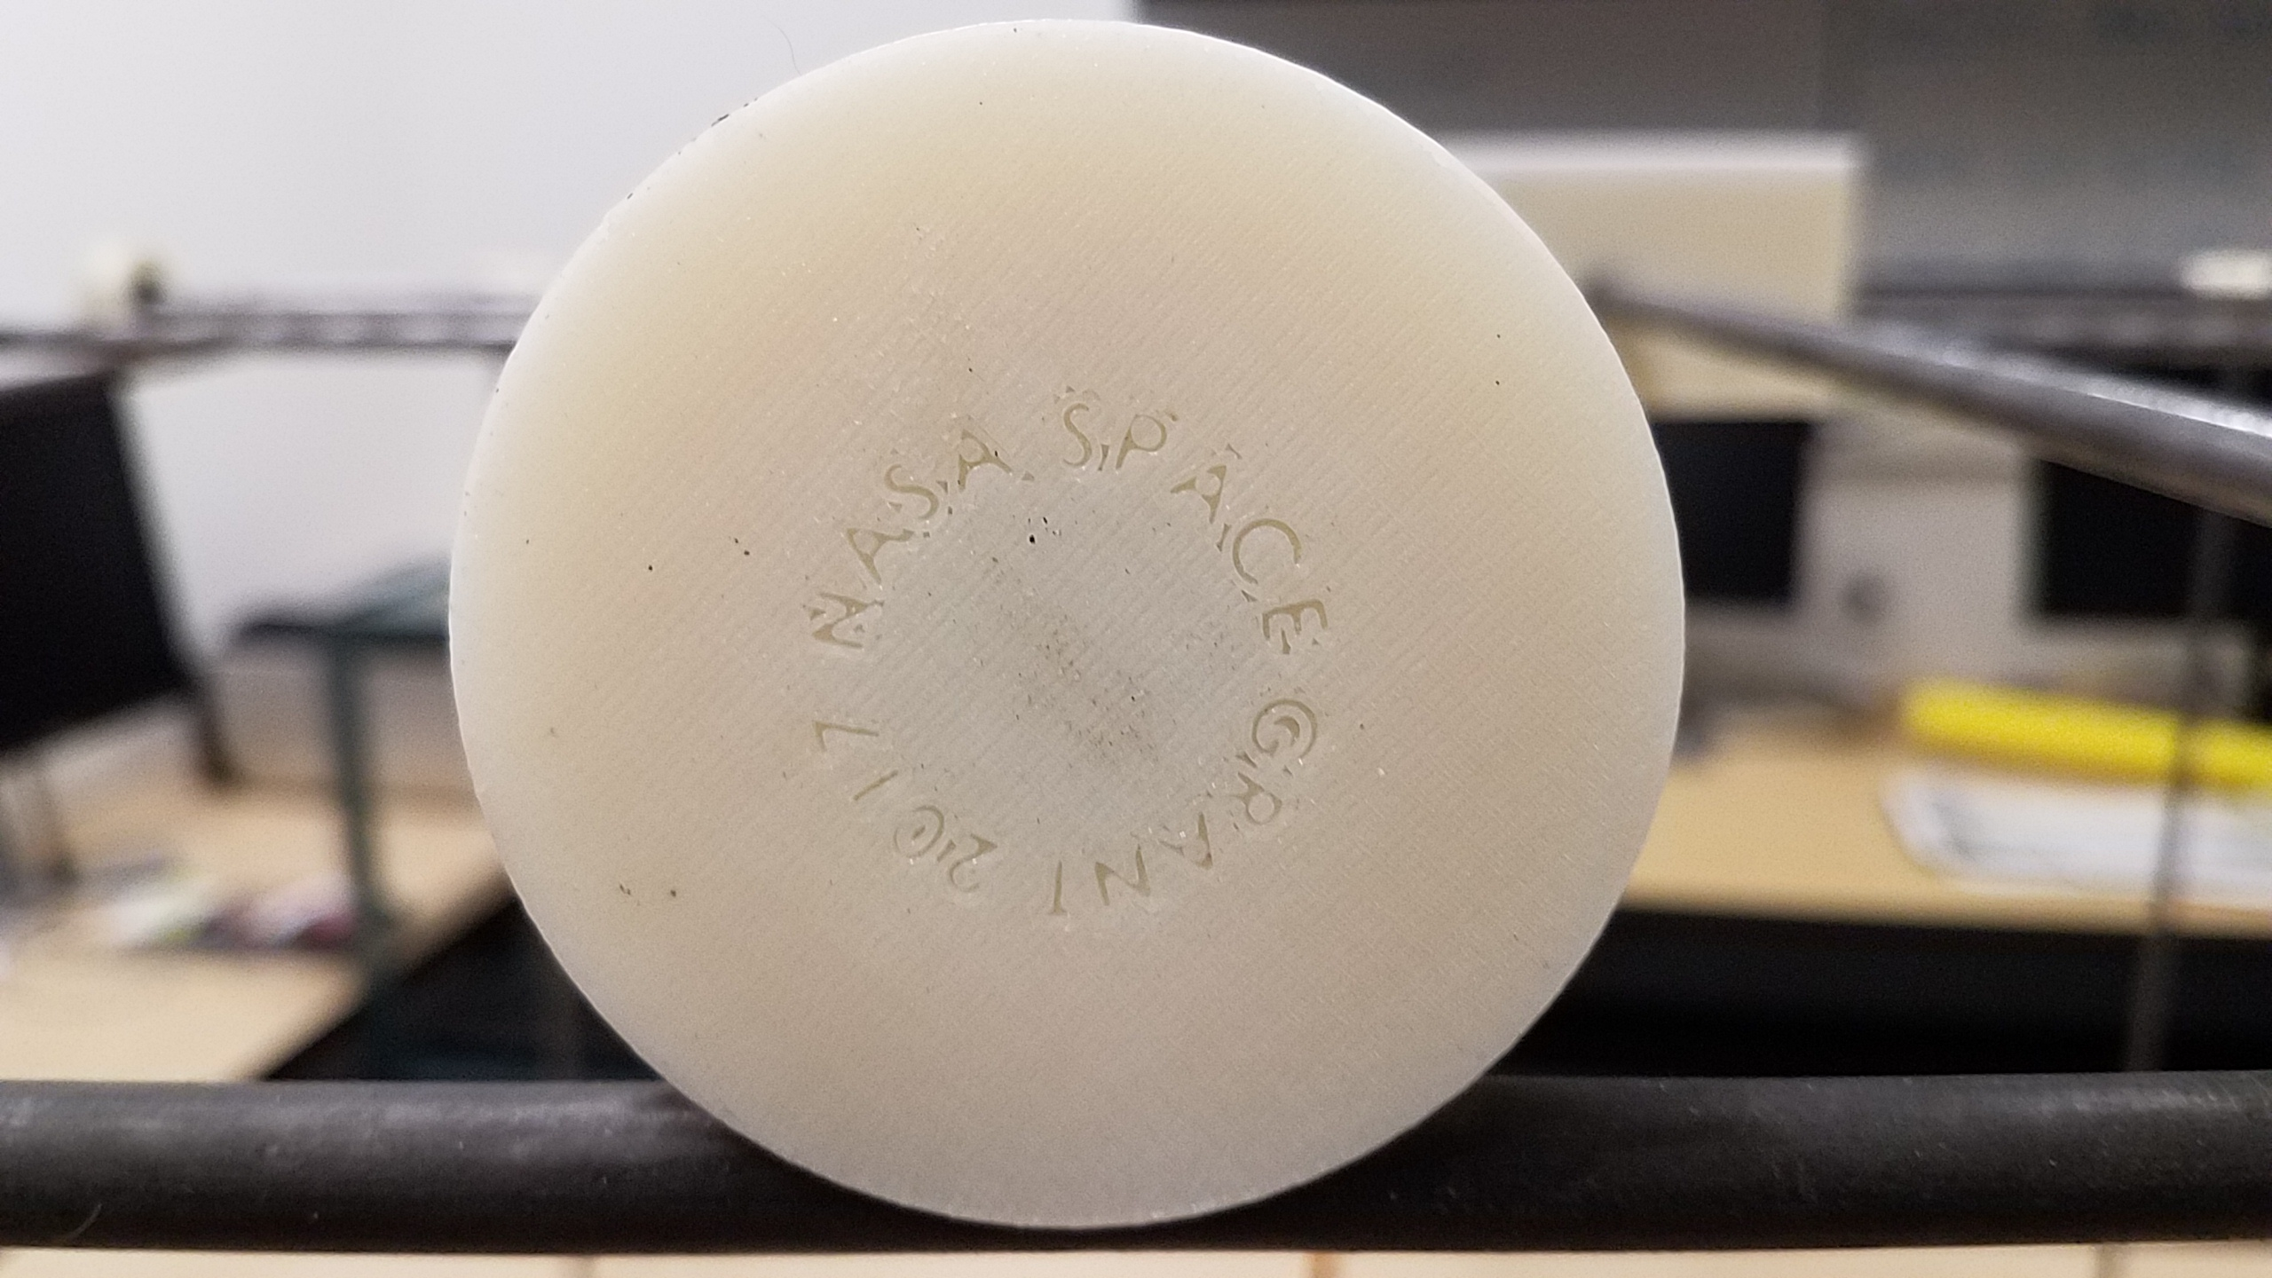
Questions?

